Slide 1
DSCI 6007
Distributed and Scalable Data Engineering
Viviane Marani - Spring 2017

Slide 2
“Business problem”
Initially:
Predict the lowest price for round-trip SFO-GRU
Recommend day of the week to buy
Current:
Predict the lowest round-trip to SFO-GRU for a specific travel date

Slide 3
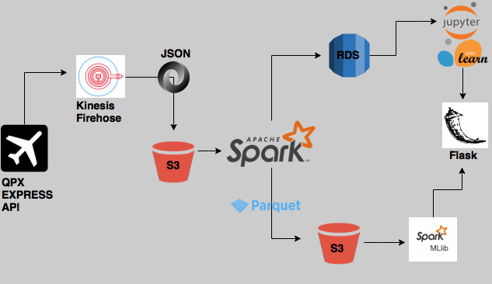
Data Pipeline

Slide 4
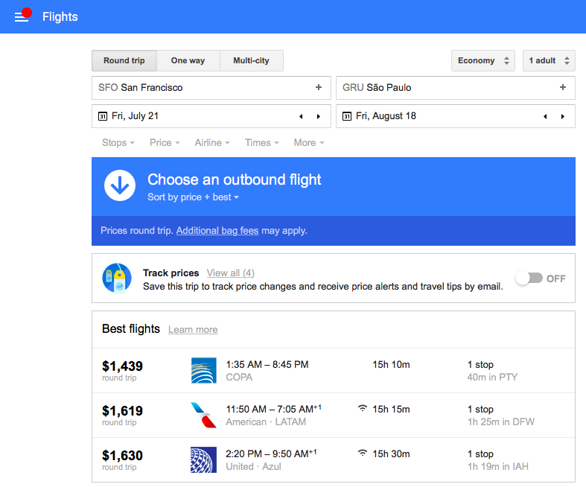
Streaming
Streamed data via Kinesis Firehose from QPX Express to S3 data Lake

Slide 5
Structuring
Use Spark to ETL (extract, transform, load) data in a distributed and scalable way from data lake and into Database

Slide 6
Storing
Store structured data in 3N in Postgres Database
Store structured data in Parquet as a backup and future development

Slide 7
Synthesizing
Applied machine learning model, Random Forest, to predict lowest ticket price.
Findings:
There was not much variation in price in the data thus the findings from the machine learning step were not too promising. The goal is to develop on this project going forward by adding other destinations and dates.

Slide 8
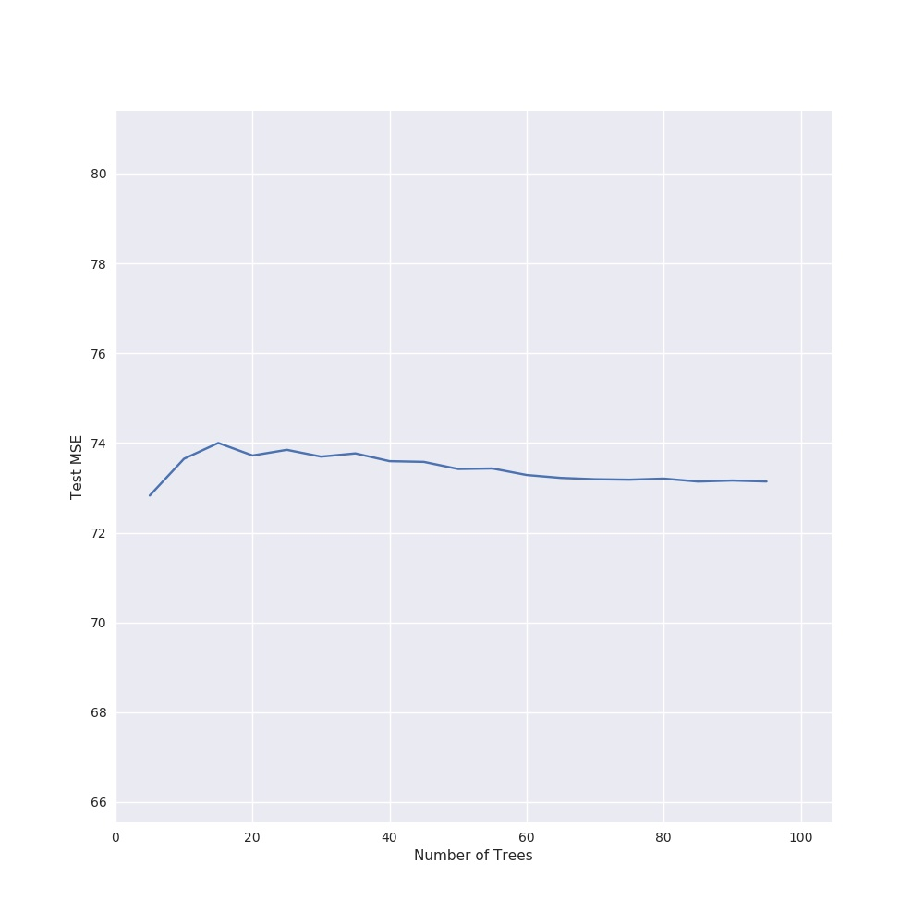
Random Forest: MSE vs Number of Trees

Slide 9
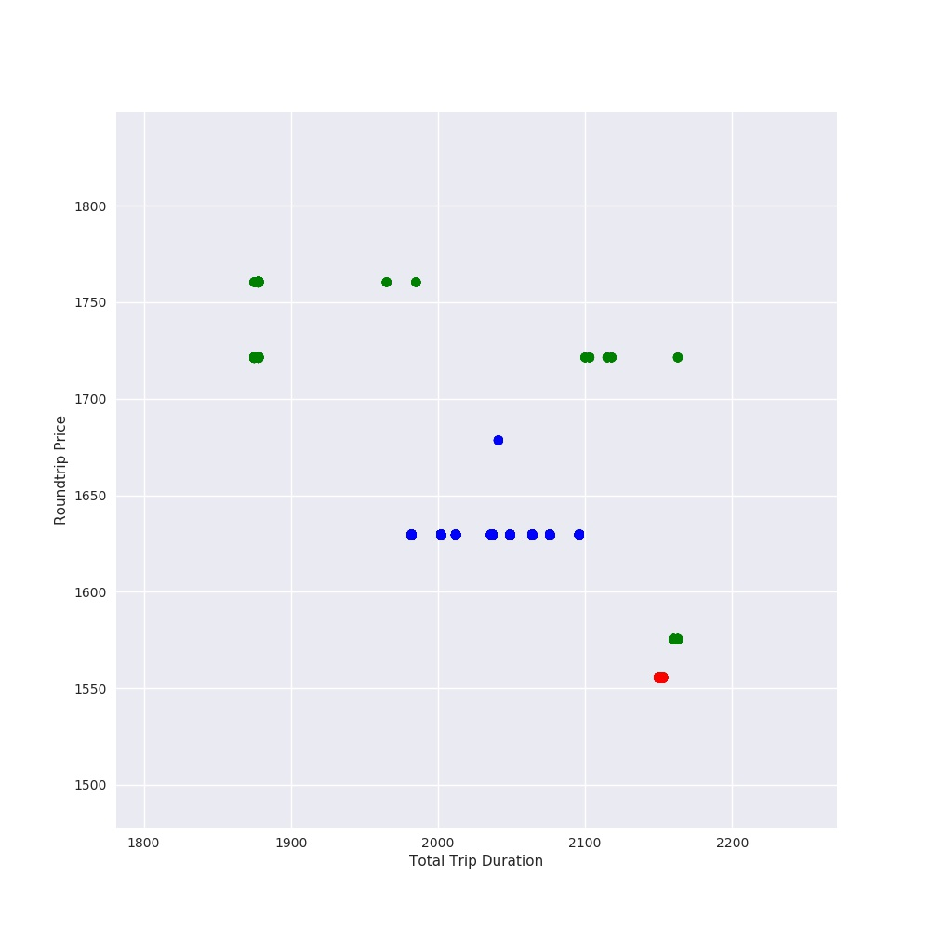
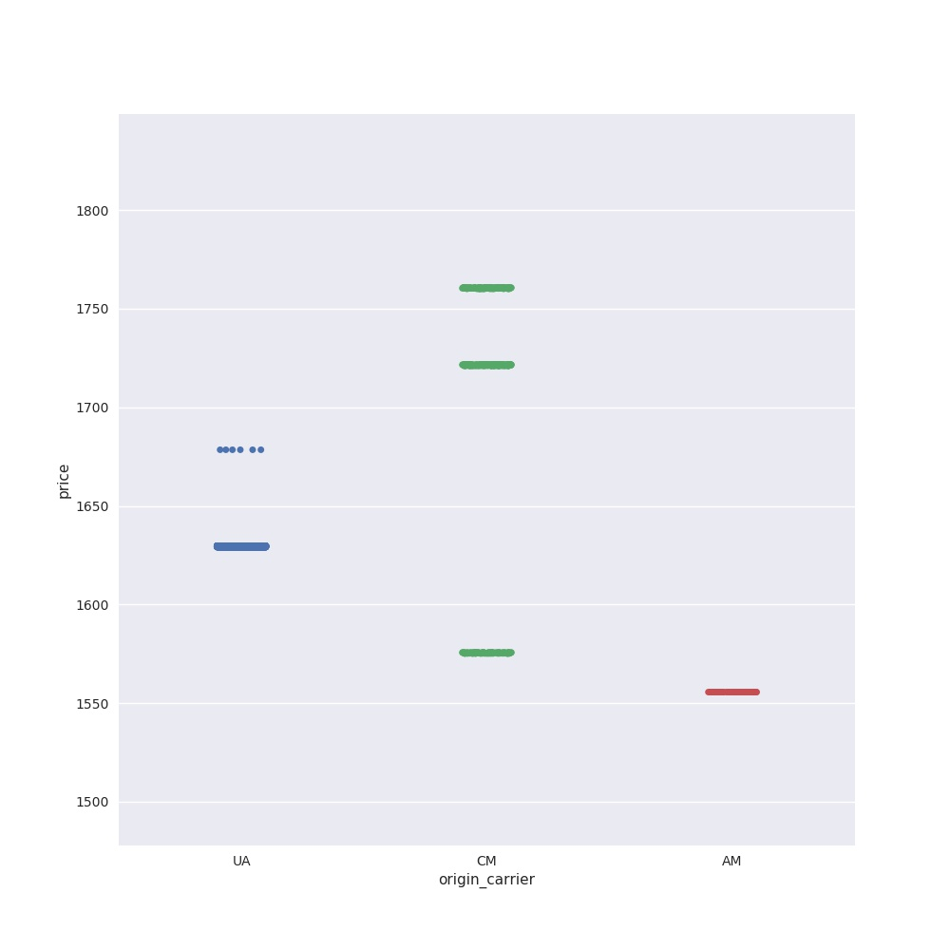
Price Variation by Airline

Slide 10
Show
Host machine learning graphs via Flask app
export FLASK_APP=app.py
Flask run
Website: http://qpxexpresshtml.s3-website-us-east-1.amazonaws.com

Slide 11
Thank you

